Slide 1

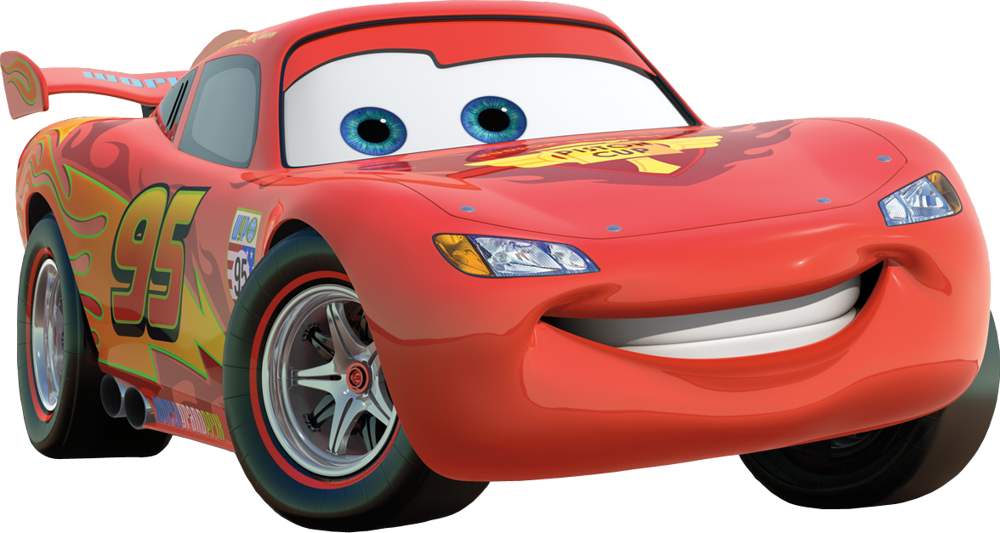
McQueen
Group no : 4
Sanita Shahrin Joyee
17-01-04-138
Nurnnaby Siddiqui Shourav
17-01-04-151
Mehjabeen Shachi
17-01-04-153

Slide 2

Overview
E-Rated, 2D, Double Player, Racing Game
a racing game which can be played Either
In the single player or double player Mode.
The goal of this game is to be the First to
reach the End without clashing

Slide 3
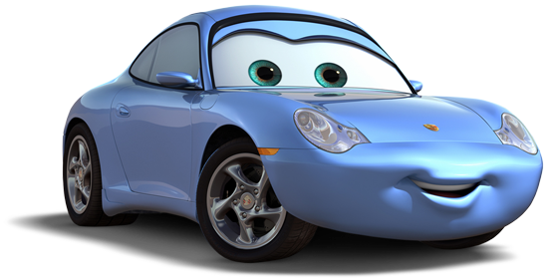
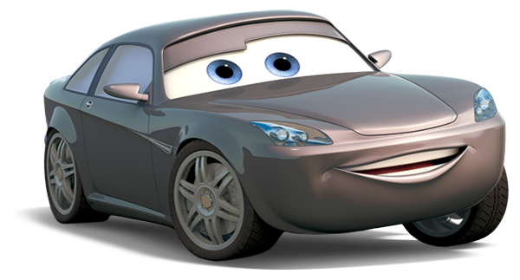
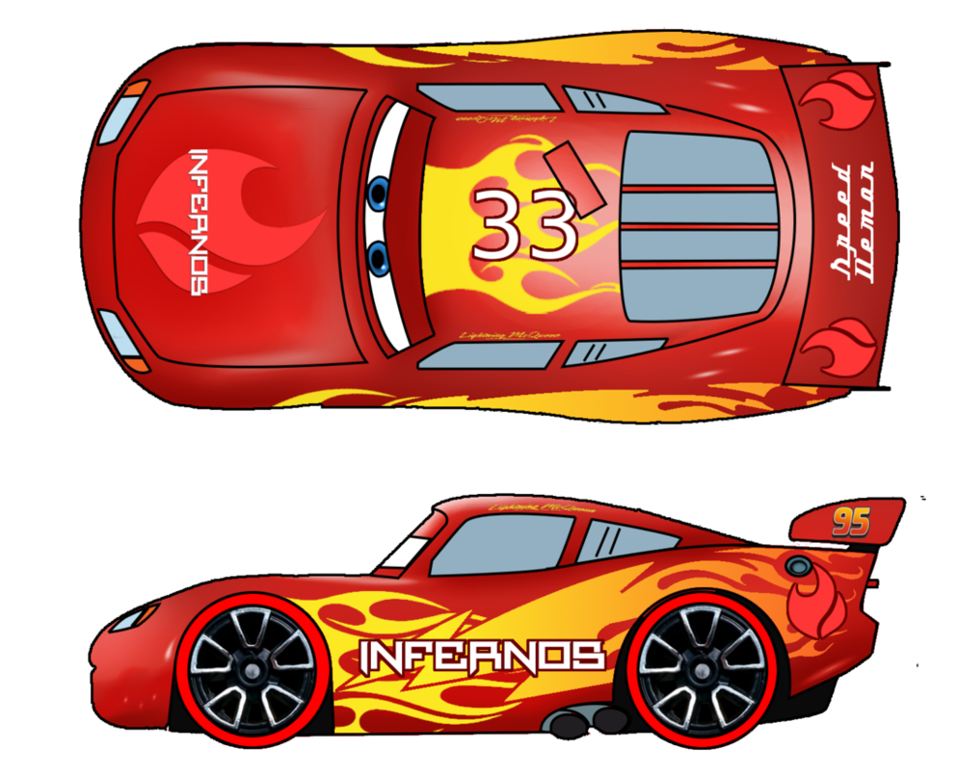
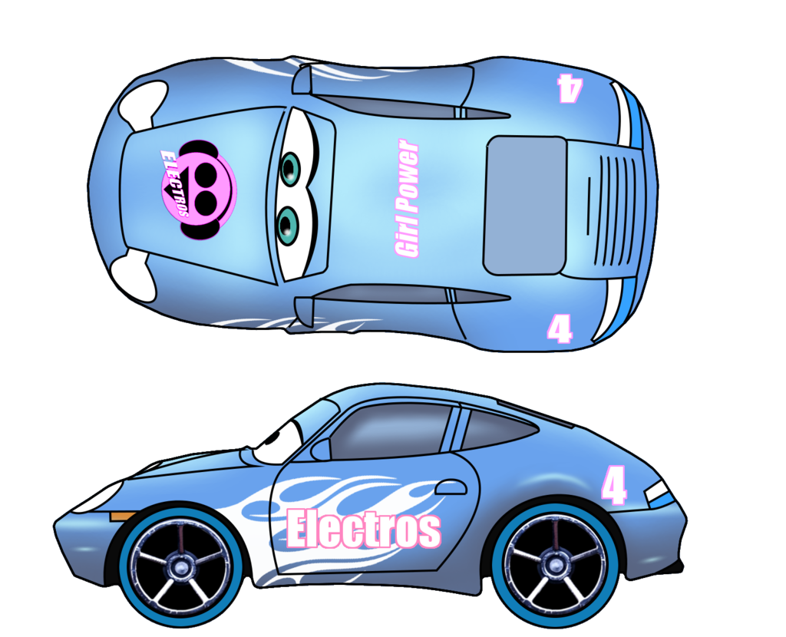
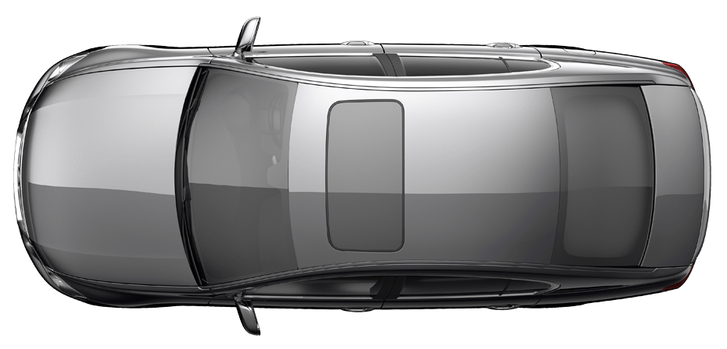

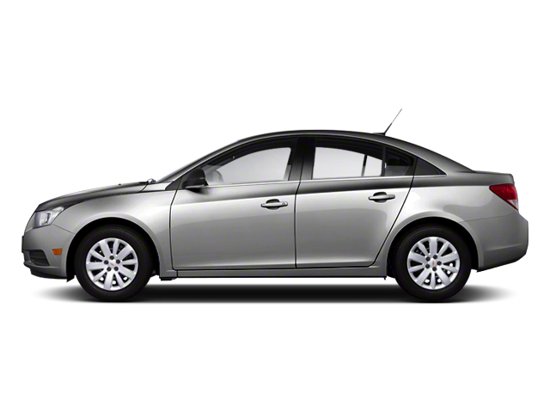
Character Introduction
First Player Second Player Extras
Lightning McQueen Sally Carrera Bob Cutlass

Slide 4


Logic, Levels & Score
Logic : The race will start with opponents having different velocities.
If the player clashes with the opponent, 1 life will be
taken away . The player will start the race with 3 lives.
player’s speed will gradually increase if there is no break.
Score : Depending on the distance crossed and collisions occurred
the score will be increased or decreased automatically
Levels : Easy, Medium and Hard

Slide 5
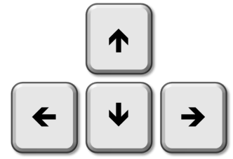
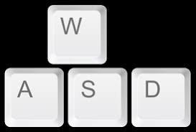



Control
User operated movement in
case of the second player (Sally)
User operated movement
in case of the first player (McQueen)
Pause
game
Resume
game
Menu tab

Slide 6

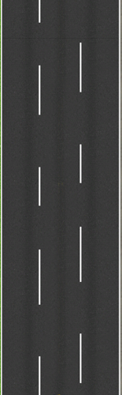
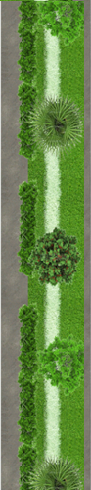

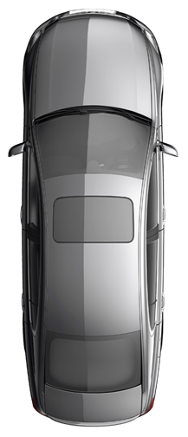
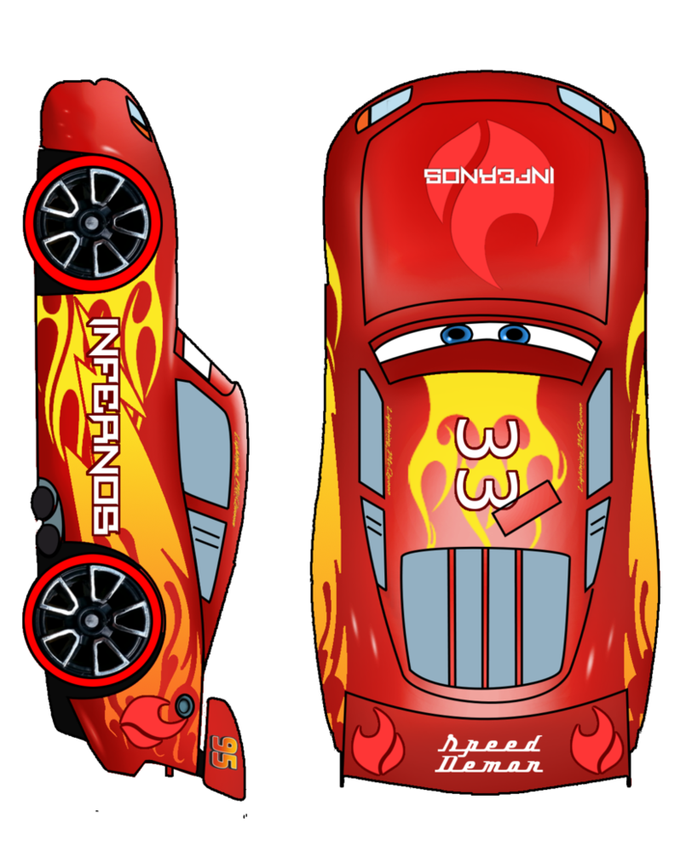
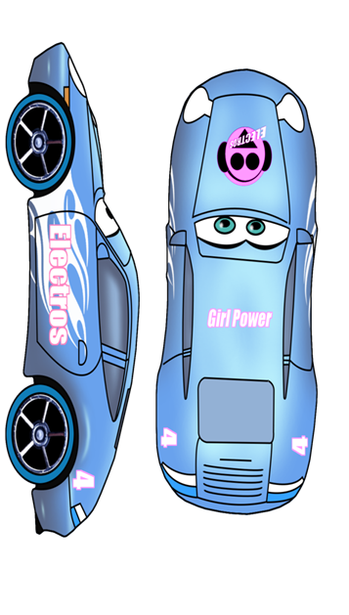

Demo

Slide 7
Parts of Coding
File : To deal with high-score and the menu
Structure : To deal with the attributes of the cars
Header File : To deal with the movements

Slide 8
Work Division
Sanita Shahrin Joyee : Score
Nurnnaby Siddiqui Shourav : Movement
& Control
Mehjabeen Shachi : Logic
& Design

Slide 9
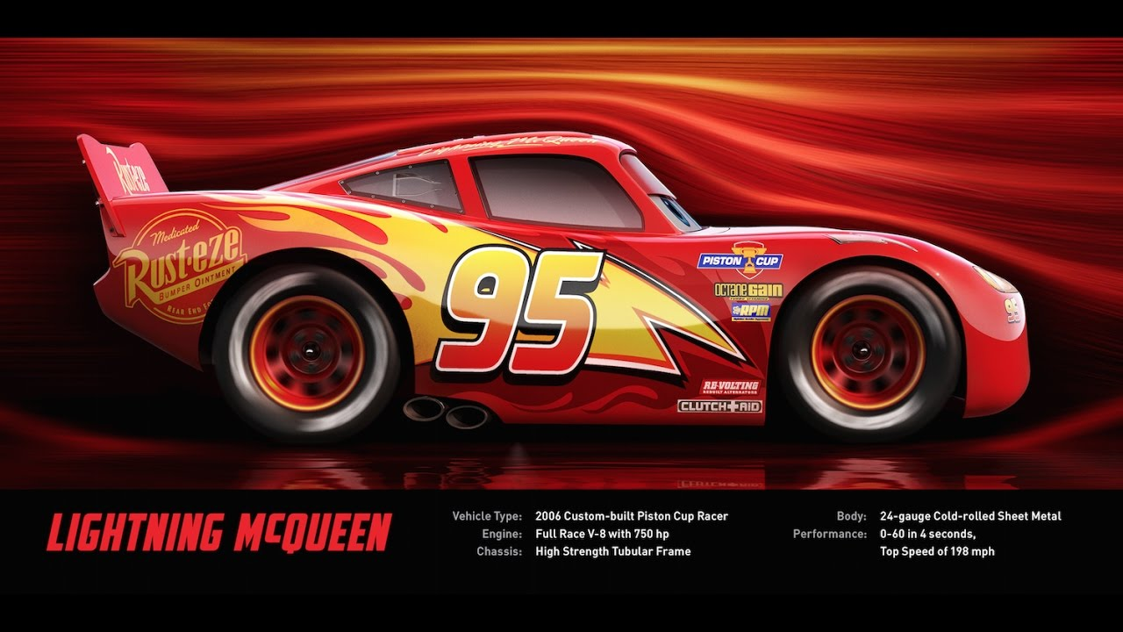

THE END
Thank You……

